Slide 1
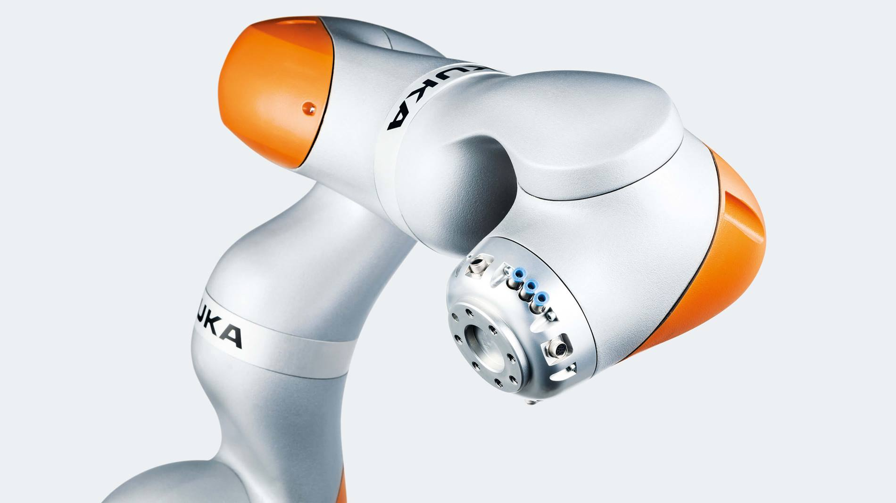

Size-based Object Marking and Segregation
Prasheel Renkuntla
116925570
source: https://www.kuka.com

Slide 2
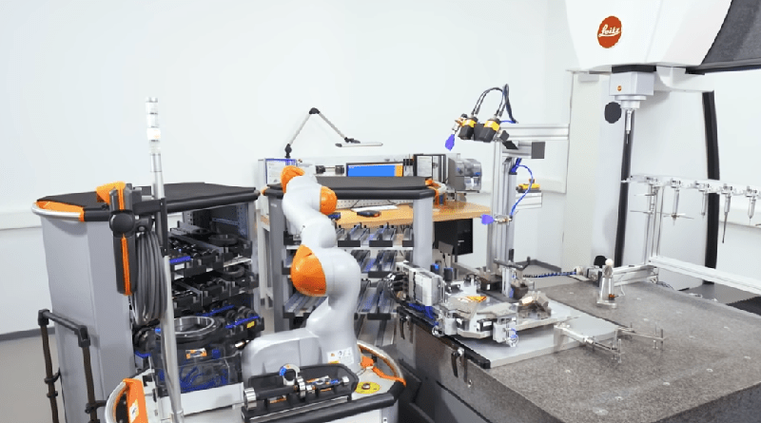

Motivation
Chemical Testing in laboratories
source: https://www.en.wikipedia.org, https://metrology.news

Slide 3
Overview
Project focuses on object grasping, and marking based on size
Here, the objects will be cuboids(representing chemical containers)
Kuka LBR 4 iiwa R820 (7DoF) arm is used with an RG2 gripper
Kinematic model of the arm and it’s contact model to grasp object is discussed
Available Kuka R820 and RG2 are utilised for simulation in CoppeliaSim(formerly VRep)

Slide 4
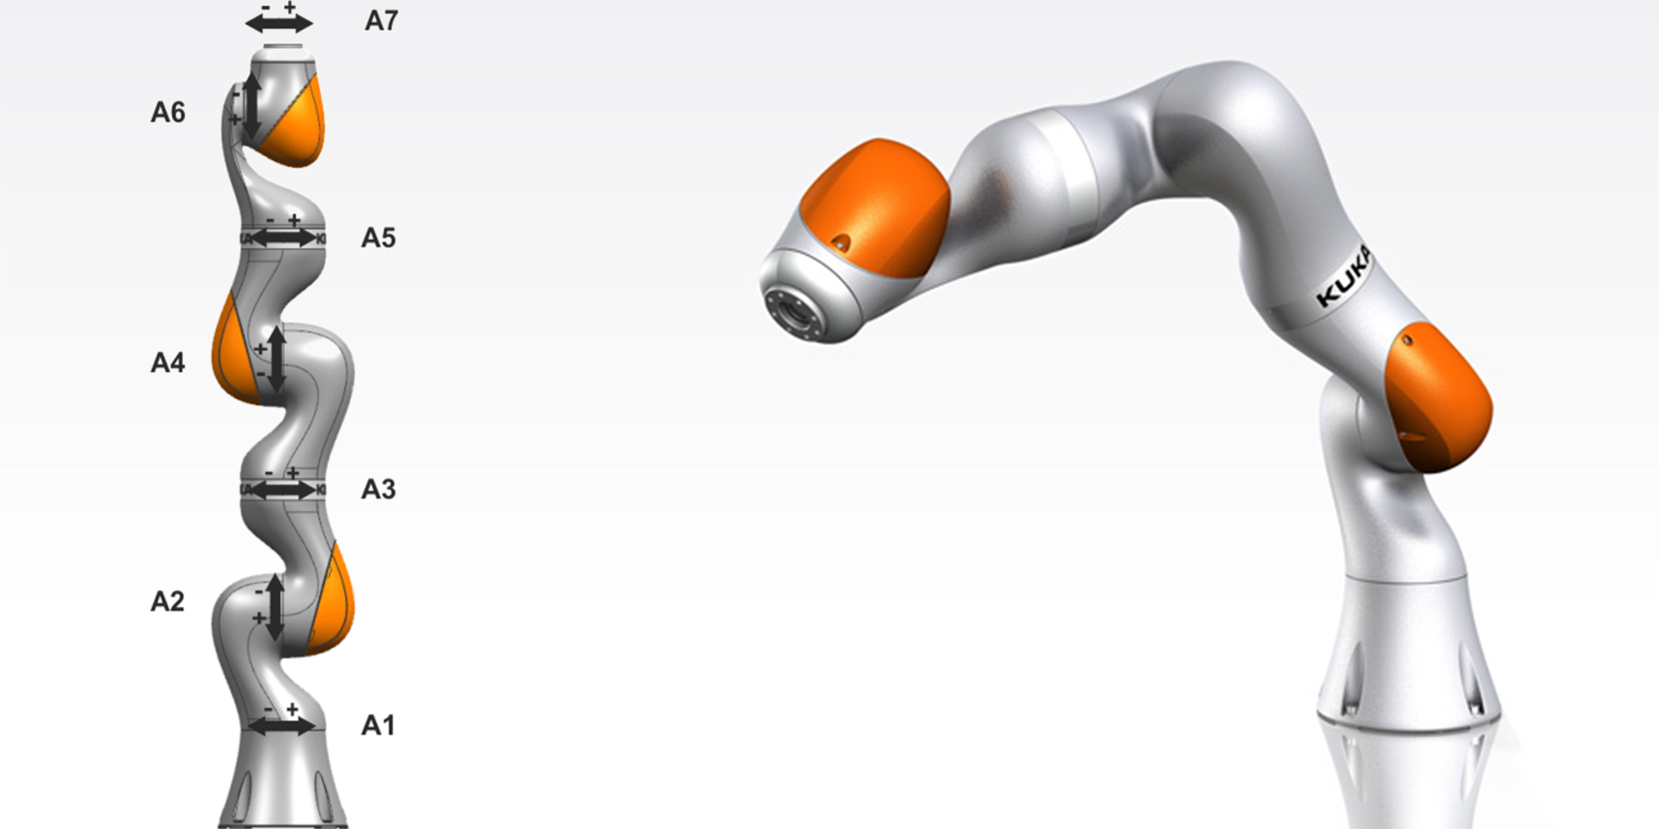
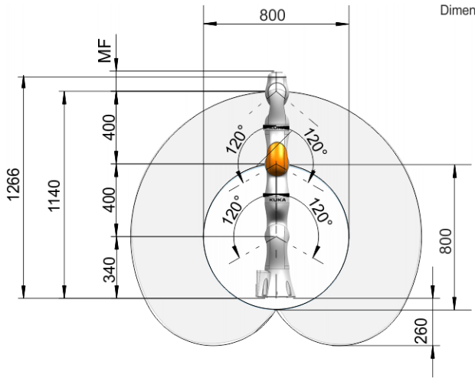
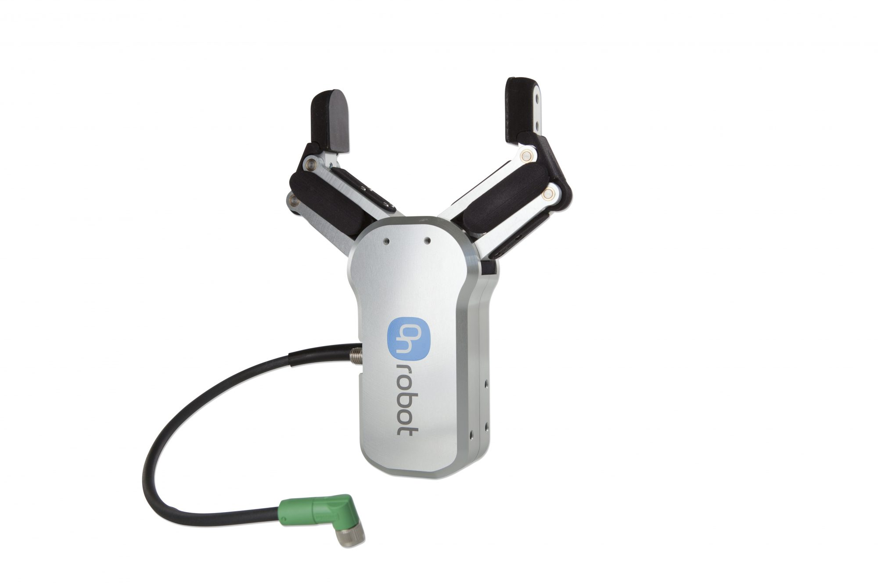
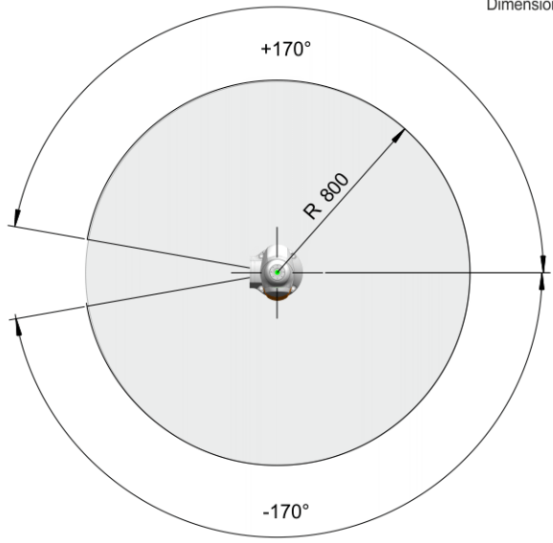
Robot Description and appropriateness
Kuka Robot Workspace RG2 gripper
source: [LBR iiwa 7 R800, LBR iiwa 14 R820 Specification Manual] & onrobots.com

Slide 5
Assumptions
Objects are rigid with high friction coefficient and fixed location
Arm is firmly mounted on the ground
Painting modifier will run only when object is in front of it
No path planning for the arm to avoid obstacles
Only kinematics are discussed as the arm moves slowly

Slide 6
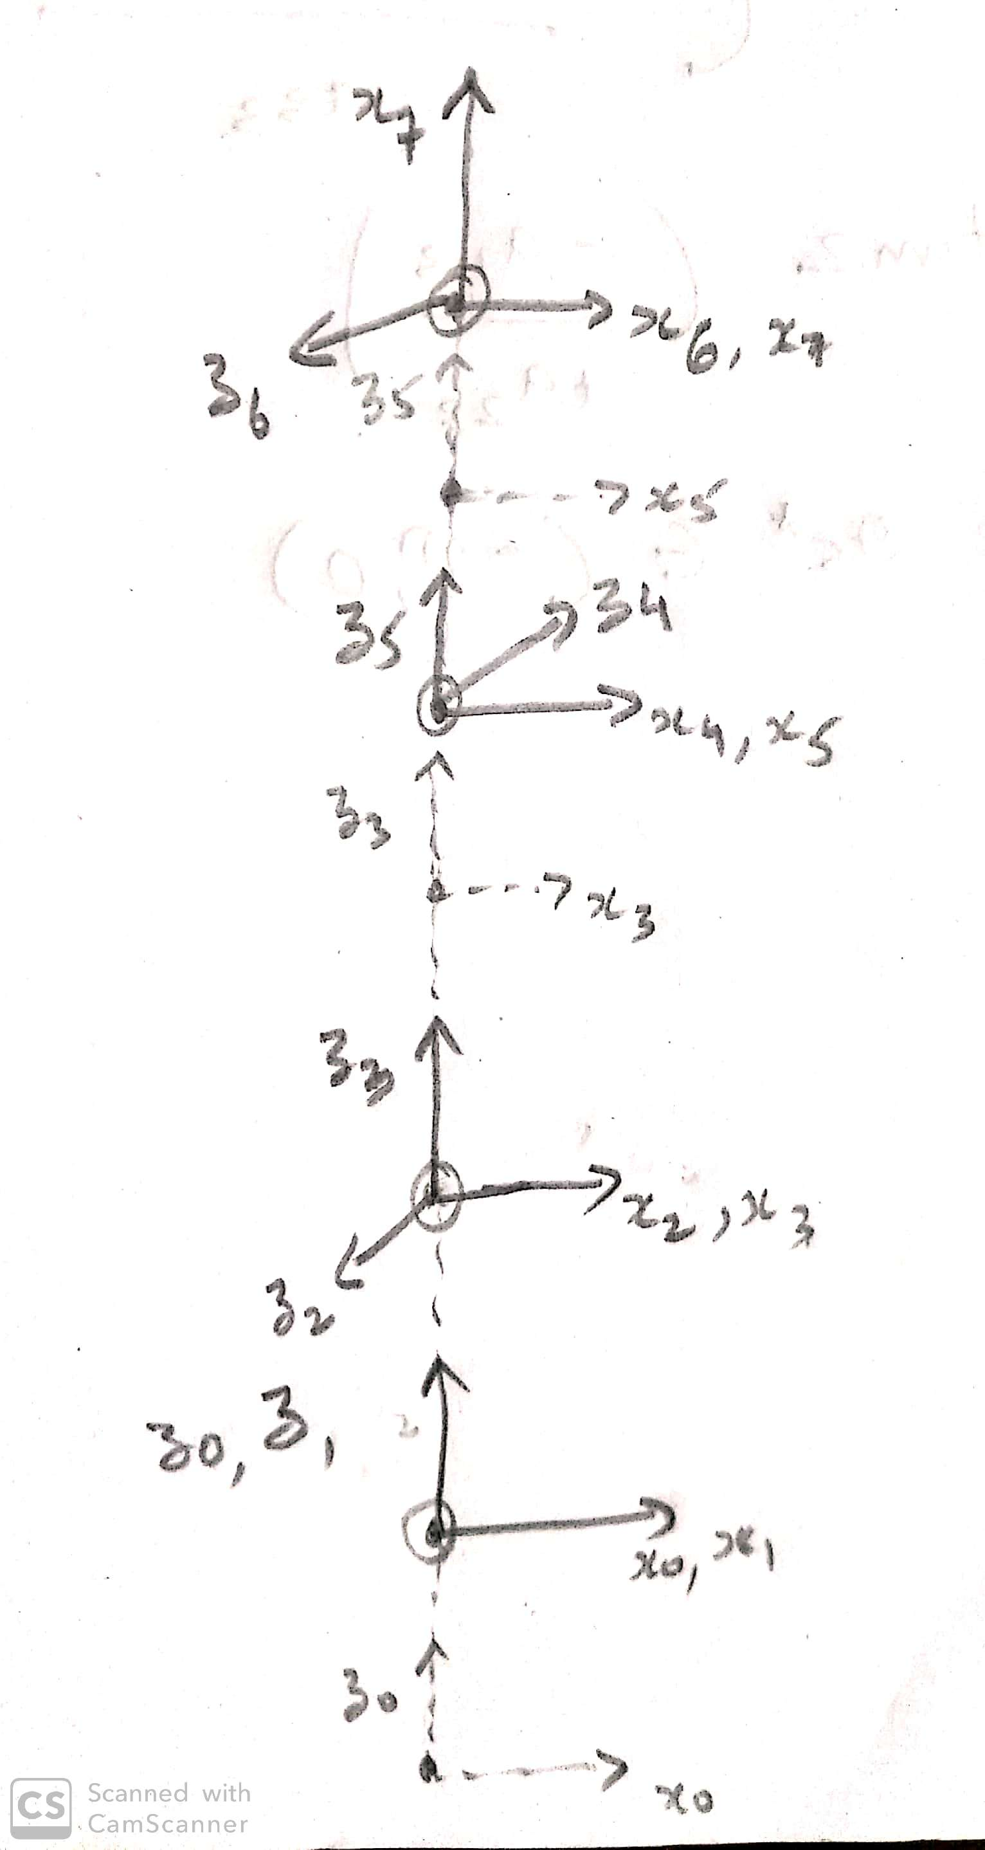
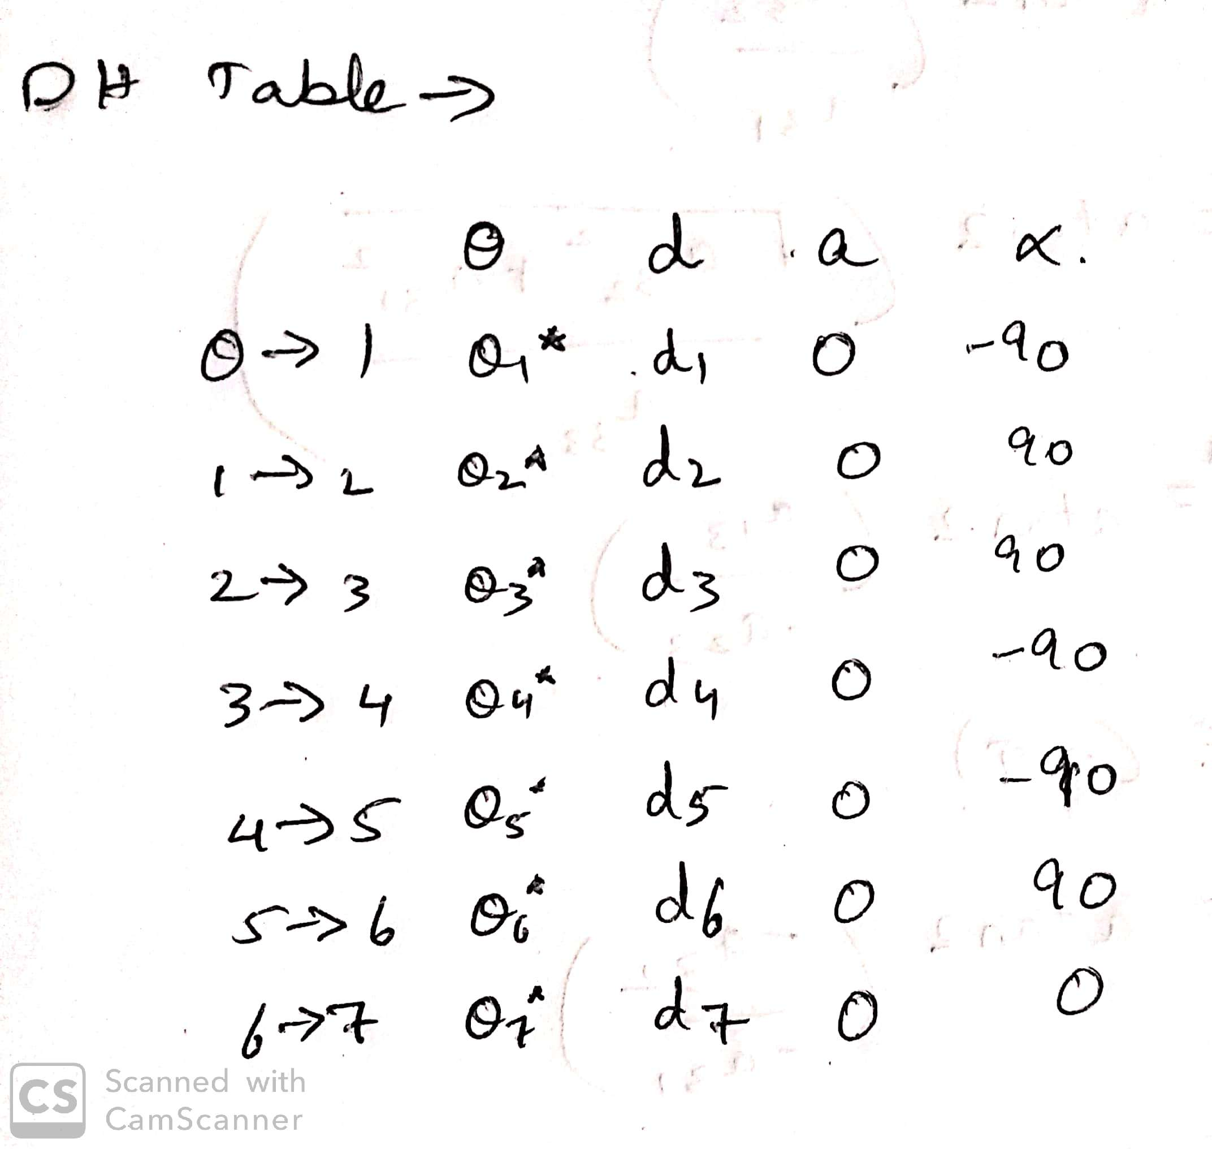
Forward Kinematics

Slide 7
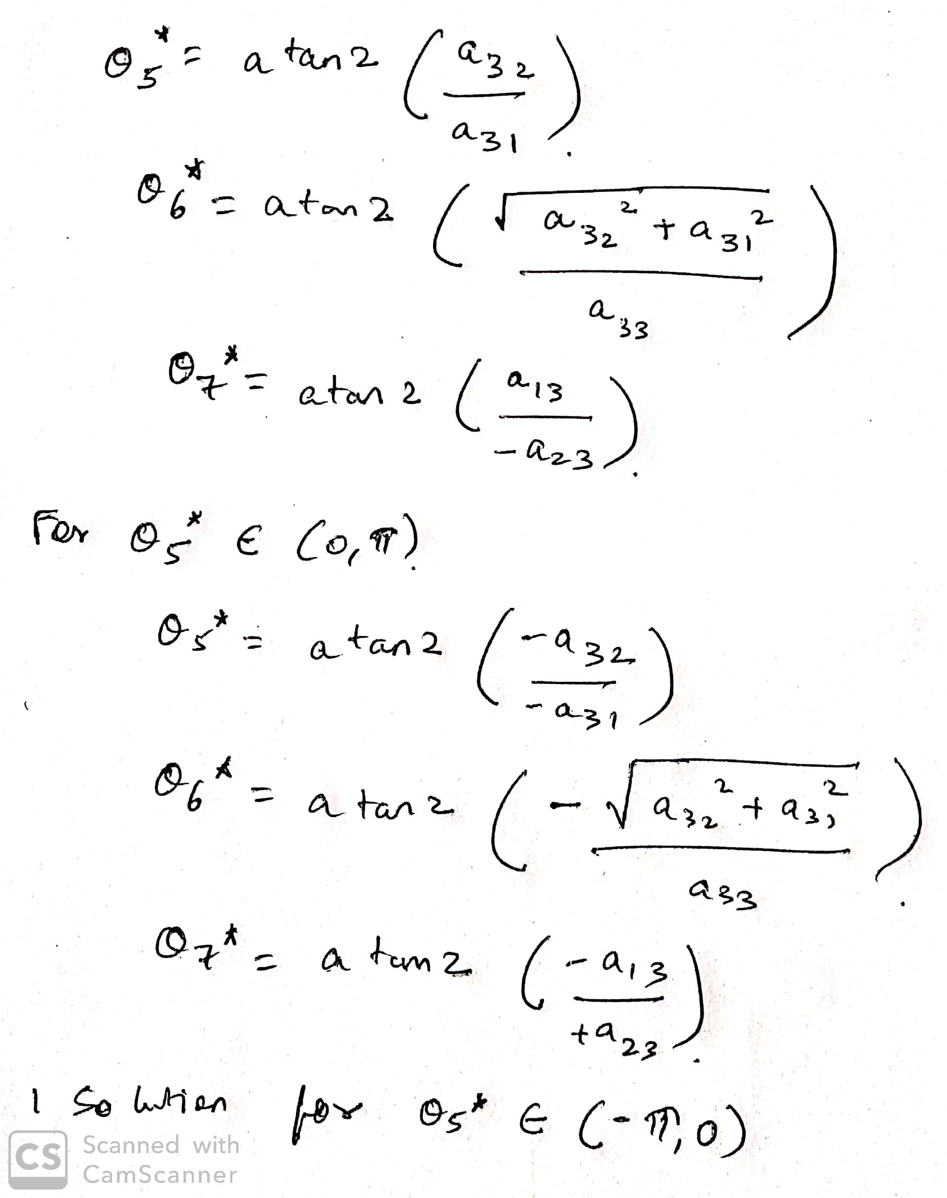
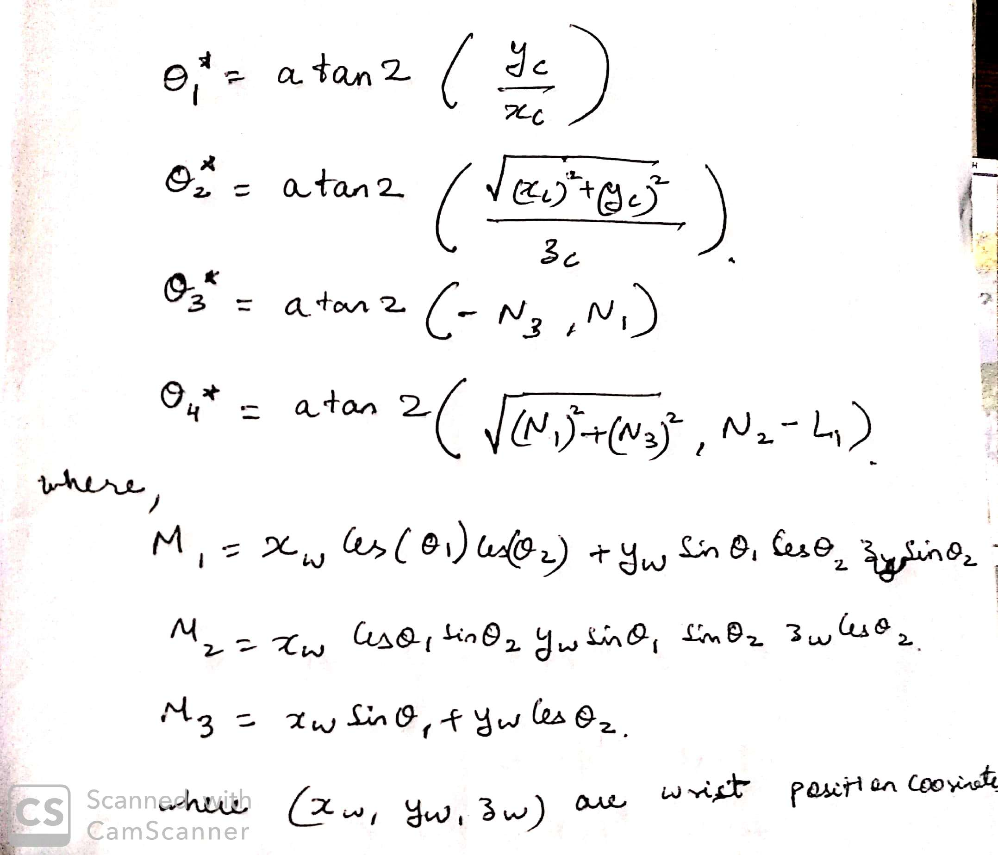
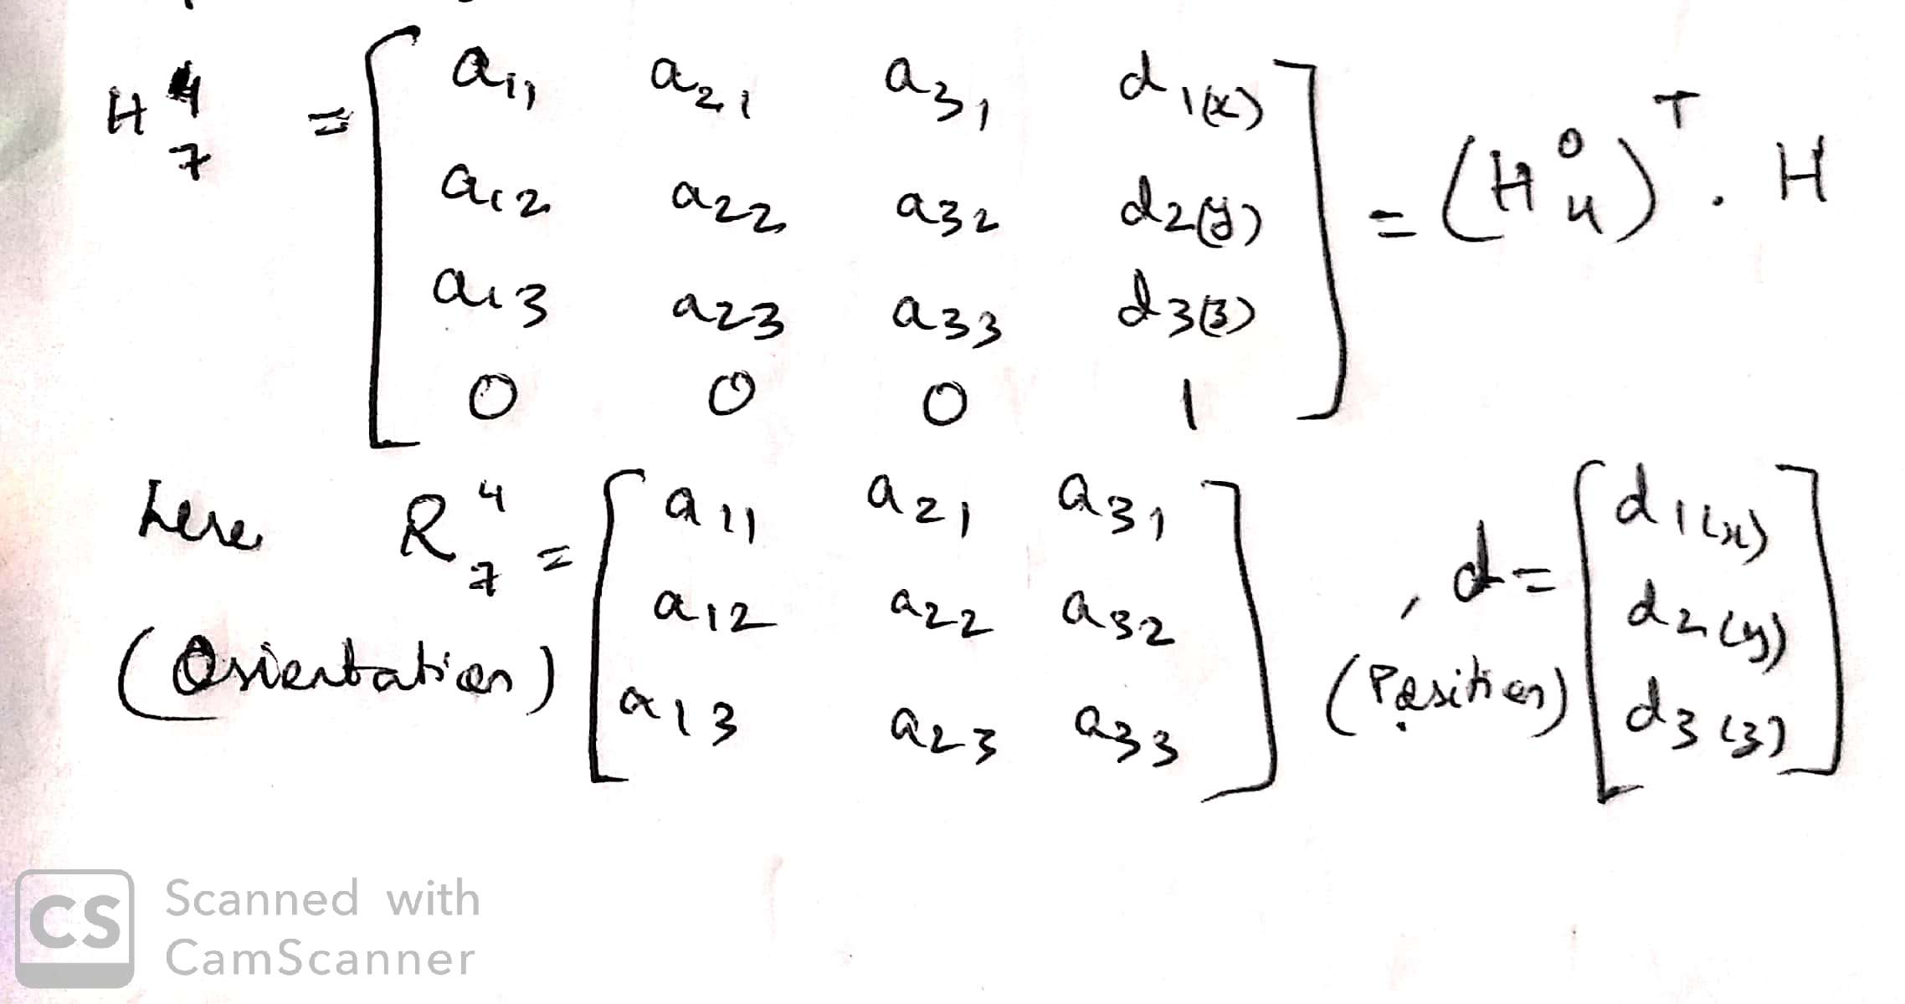
Inverse Kinematics

Slide 8
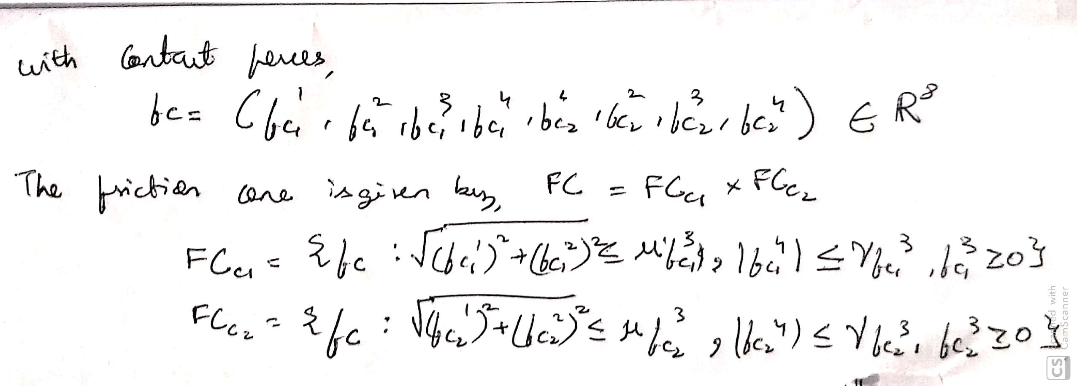
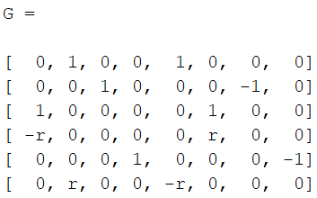
Grasping
Two contacts on the container(object) to pick, hold and place
Container is rigid with high friction coefficient for simulation
Soft finger model with two contacts for grasping
Grasp map:

Slide 9
Applications
Chemical testing
Product packaging
Food manufacturing plant

Slide 10
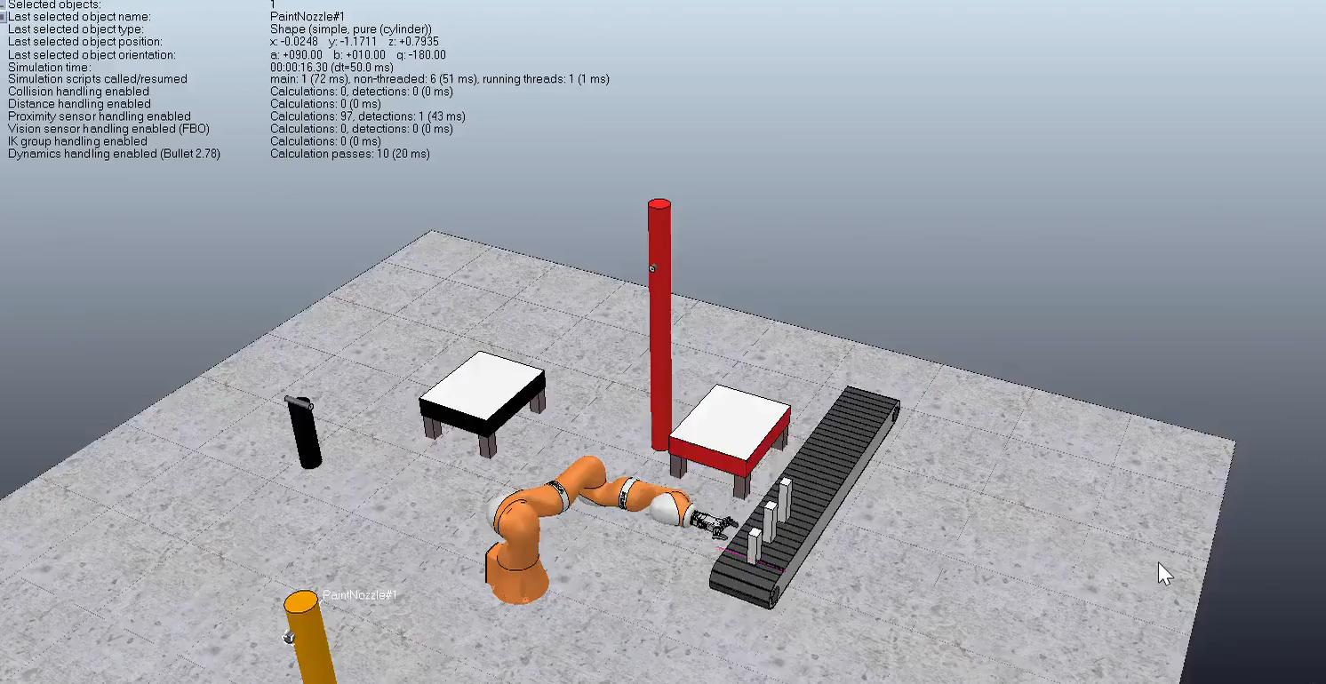
Simulation

Slide 11
Evaluation of model
Using angles [q1,q2,q3,q4,q5,q6,q7]^{T} = [70, 90, 90, 0, 90, 0, 90]^{T} , the gripper reached first painting site at (-0.0501m, 0.6916m, 1.0381m)
Given point coordinates at (x,y,z) = (0.8452m, 0.3754m, 0.2748m), following were the joint angles to reach this position in simulation:
[q1,q2,q3,q4,q5,q6,q7]^{T} = [74.99, 95.00, 88.89, 75.00, 89.98, 0.00, 90.00]^{T}
For a resultant frictional force of 20N, the gripper held the object firmly in its grasp, thus validating the contact model
The kinematic model was also confirmed from conference and journal papers

Slide 12
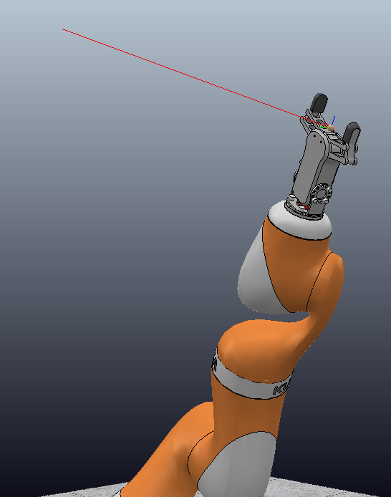
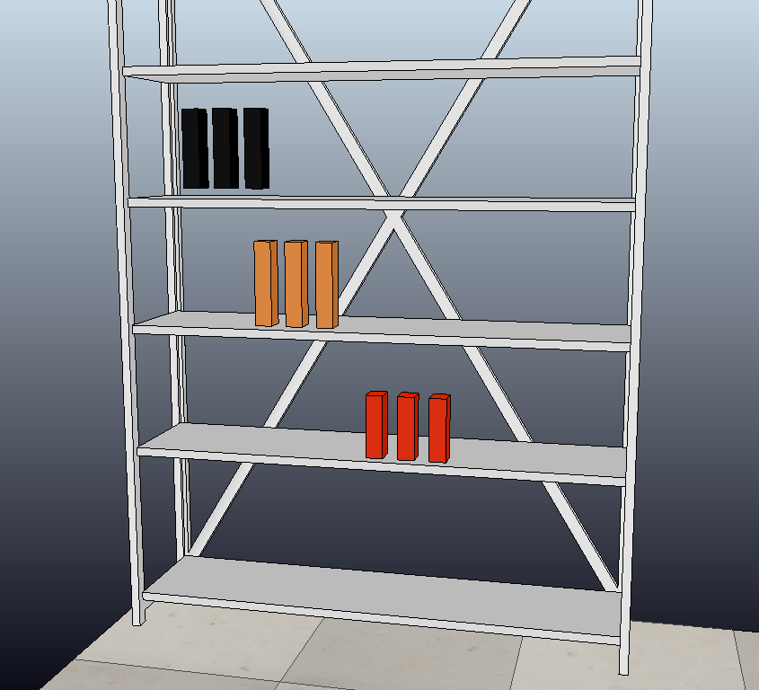
Future Work
Path Planning Completely autonomous

Slide 13
Questions?

